Slide 1
Find & Explore
One Destination For All Your Destination Plans!

Slide 2
Introduction to System
The purpose of this study was to develop Tourism Information System. It’s used to know about tours from anywhere in the world by a single dynamic website which will help the user to know everything about the places and tour details in a single website. It is a user-friendly platform for all travelers which can be easily used to know all details. Nearly everyone goes on a vacation and for them ‘Find & Explore’ would play a vital role in planning the perfect trip. The Tourism Information System allows the user to access all the details such as location, accommodation, activities etc.
The Tourism Information System thus offers functionalities to quickly access Places, Hotels, Restaurants and Commute. It provides up to date information, revised hotel rates and transport schedules. This will therefore establish ease of approach between tourists and their desired vacation.

Slide 3
Objectives
This website will strive to:
To ensure tourists find their desired information.
To manage the information about various travel destinations within Maharashtra State.
To check the current rates of hotels.
One stop destination for all your travel enquiries.
Support fast searching.

Slide 4
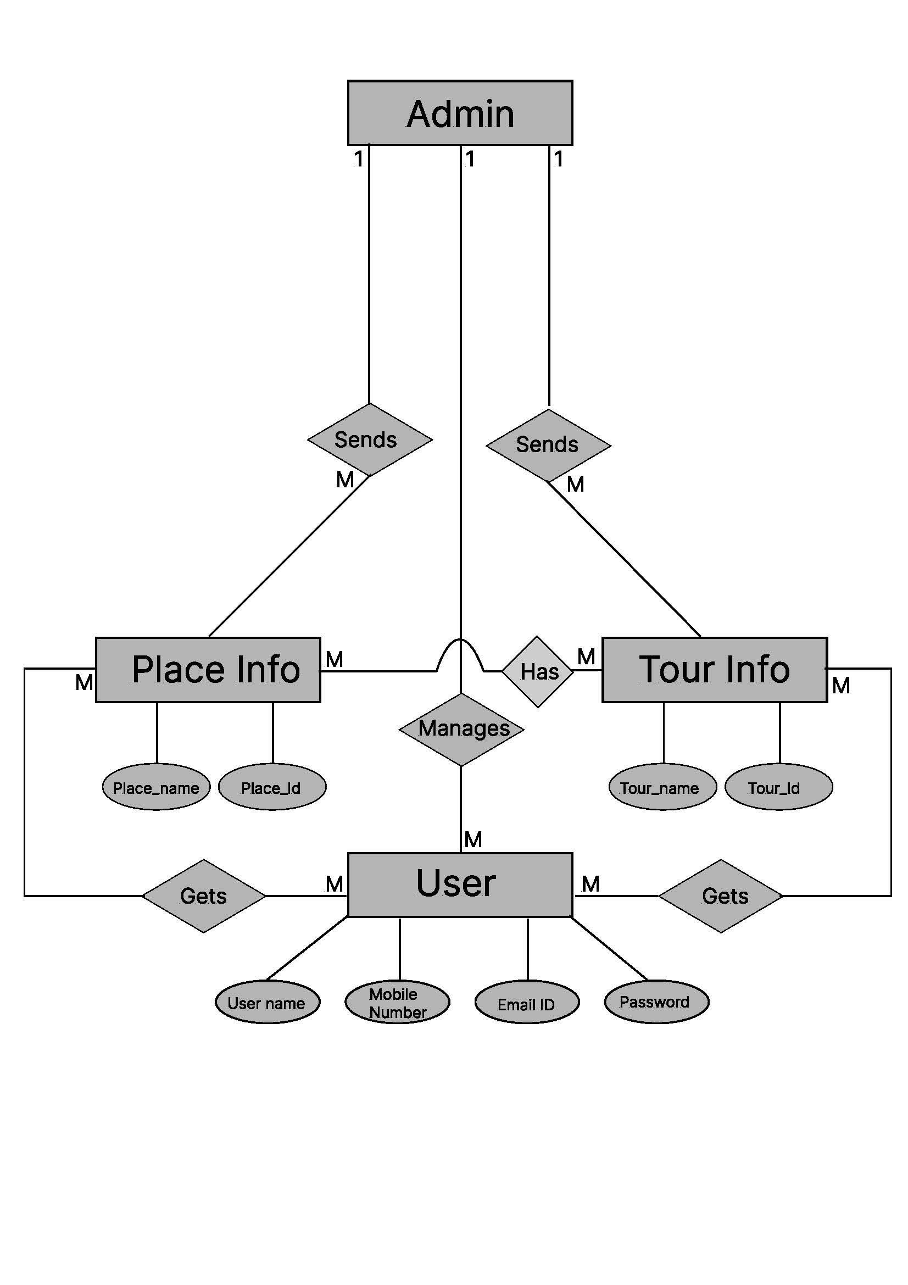
System Design

Slide 5
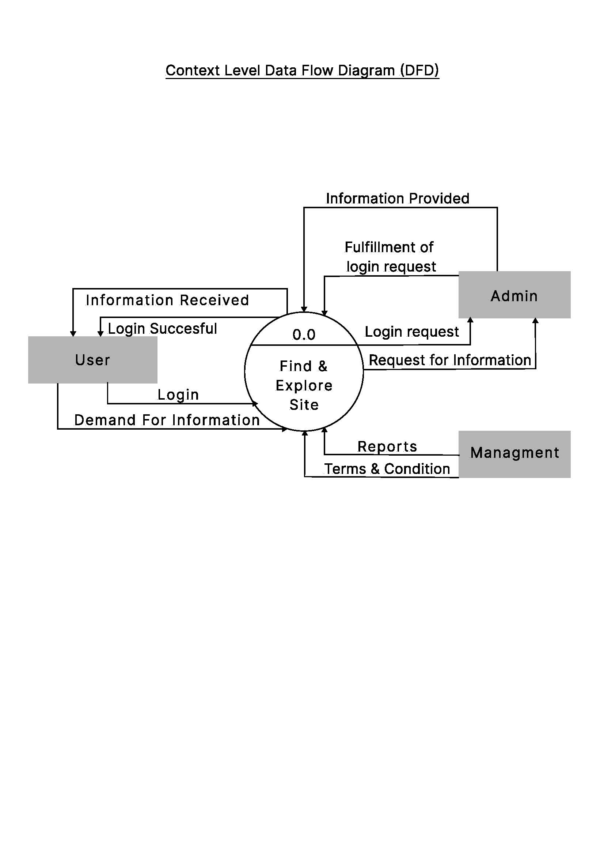

Slide 6
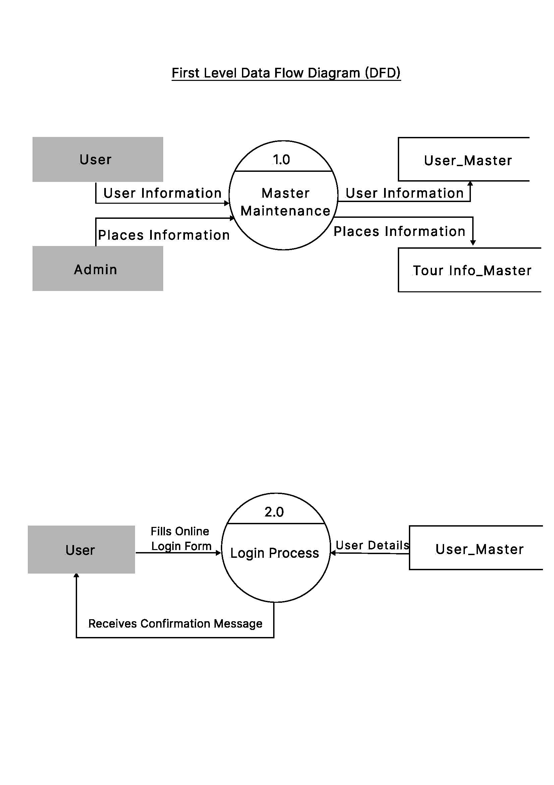

Slide 7
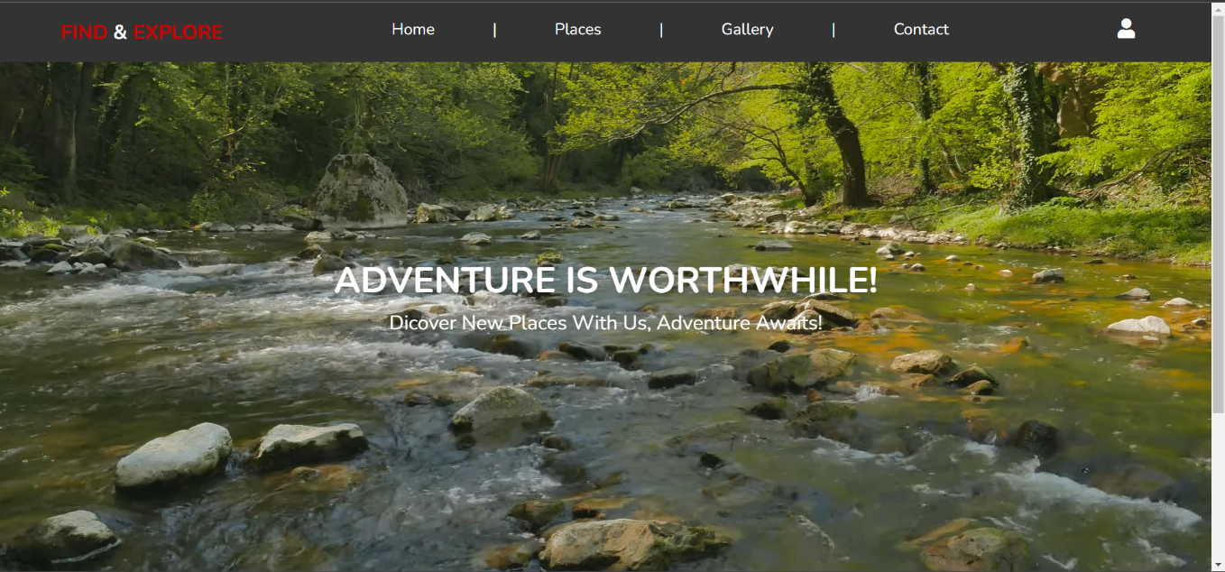
Form Design

Slide 8
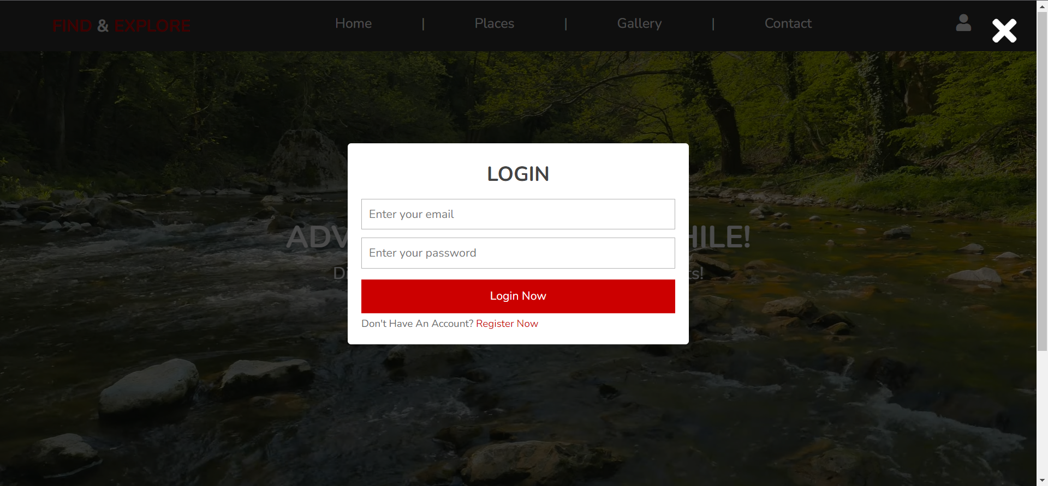

Slide 9
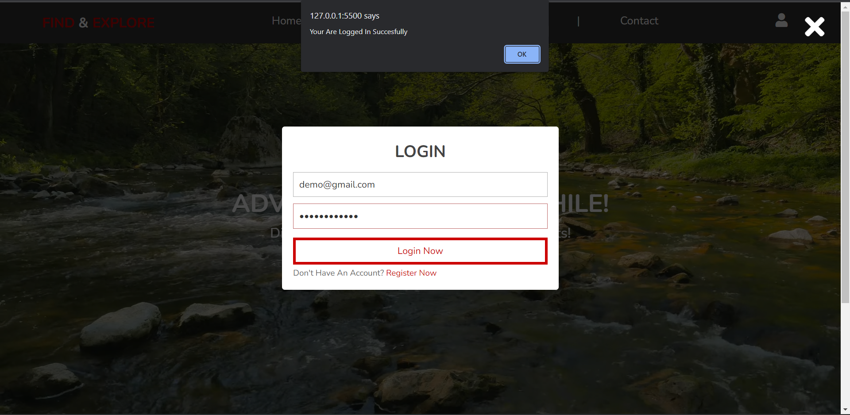

Slide 10
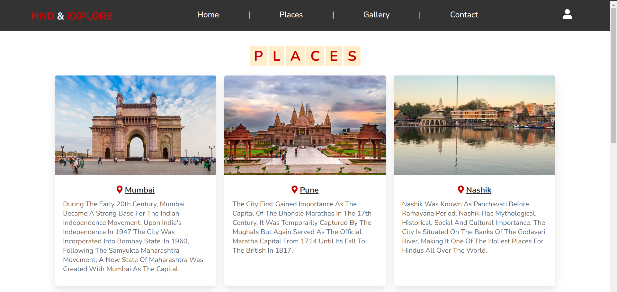

Slide 11
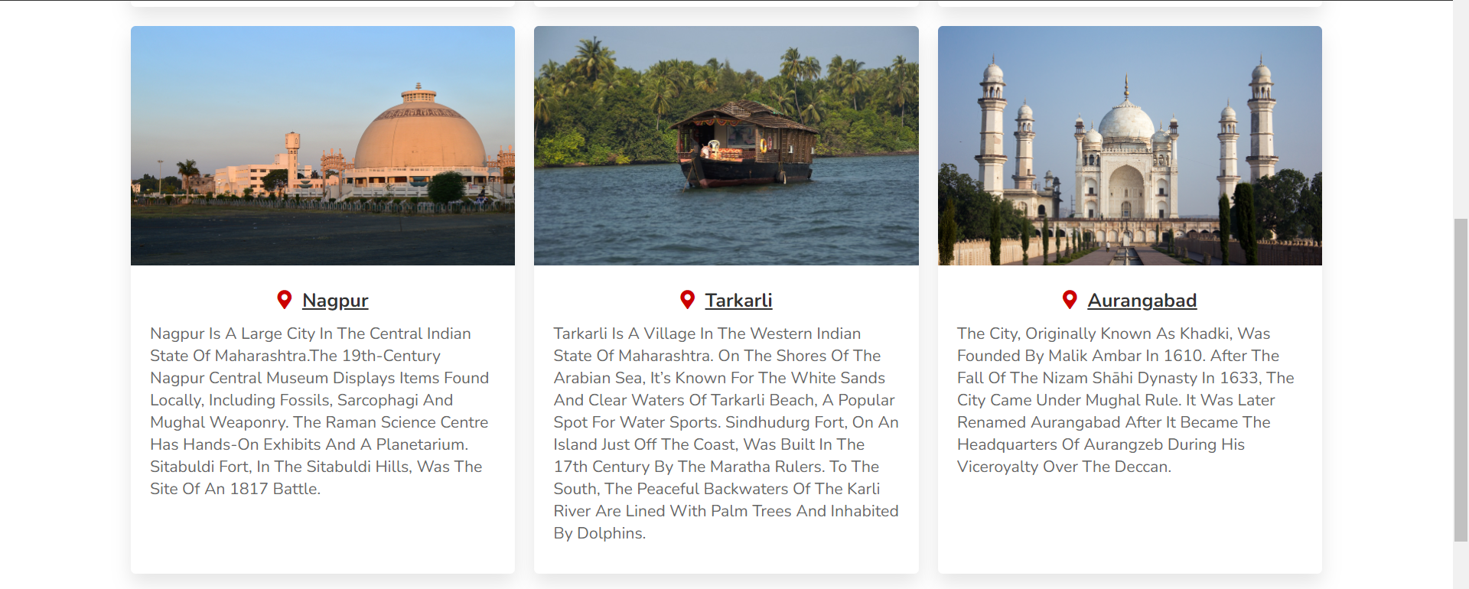

Slide 12
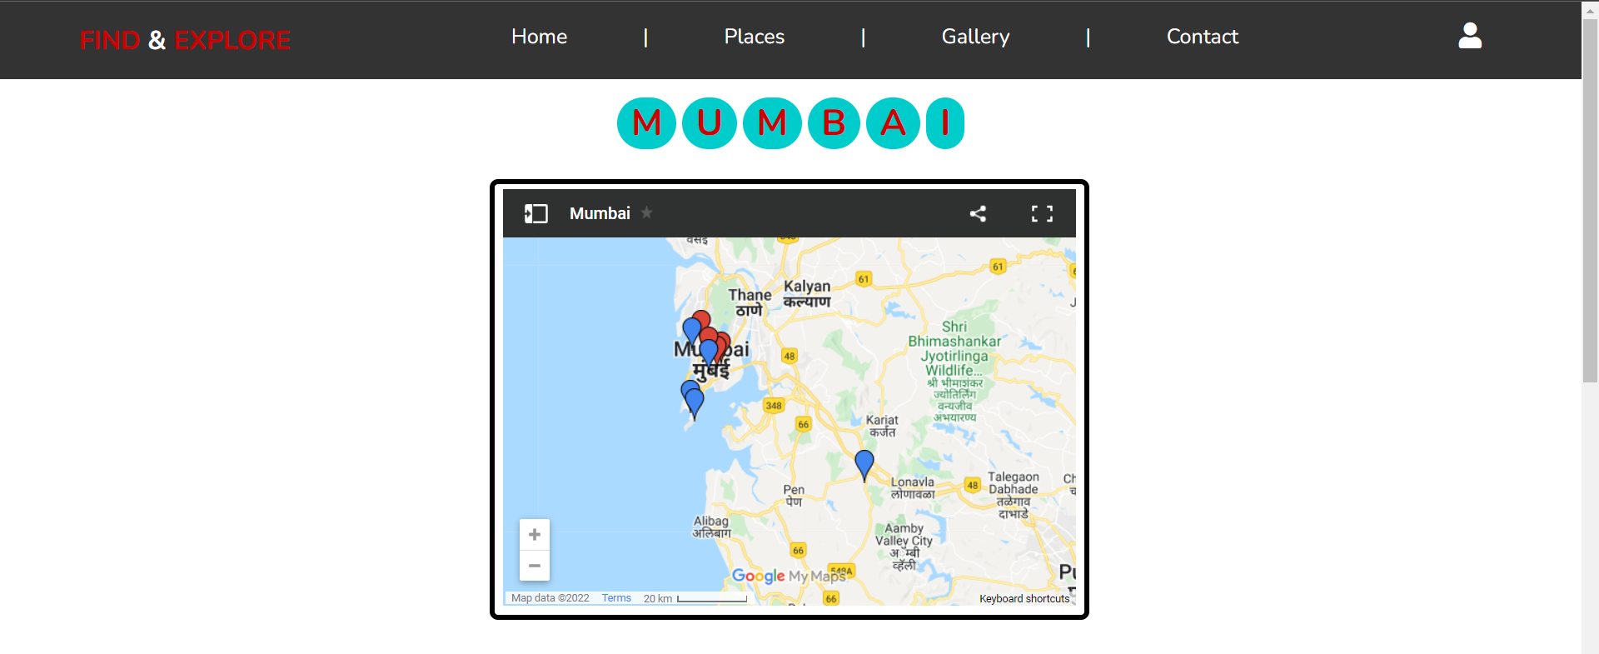
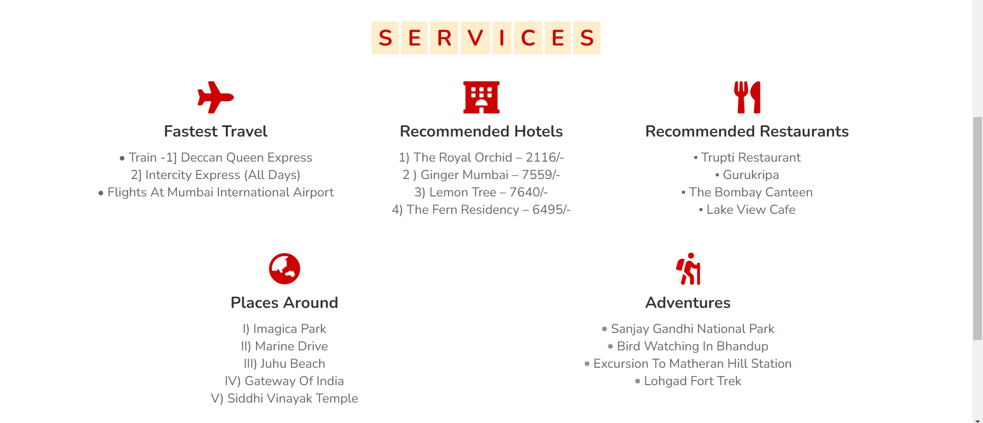

Slide 13
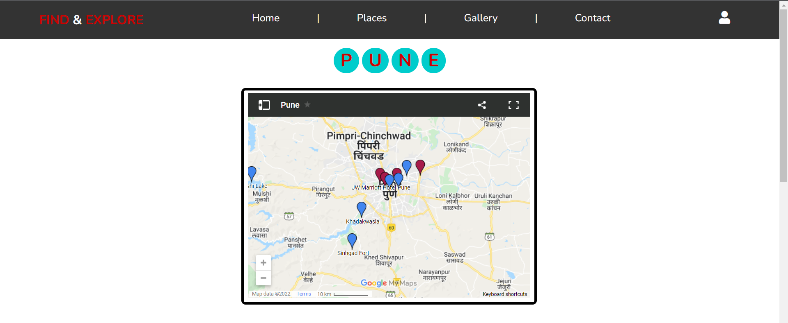
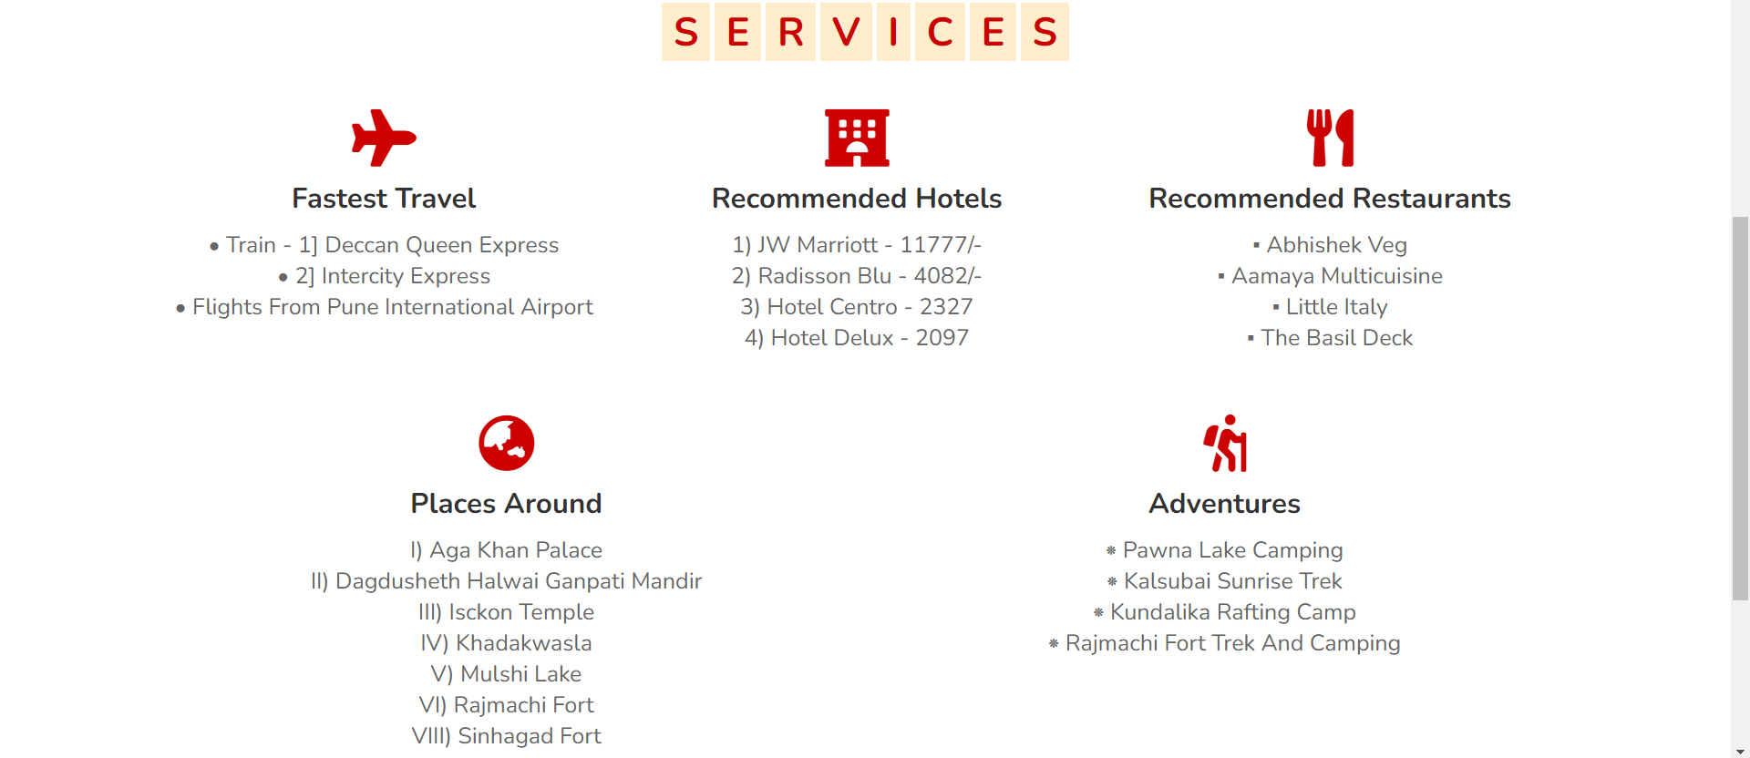

Slide 14
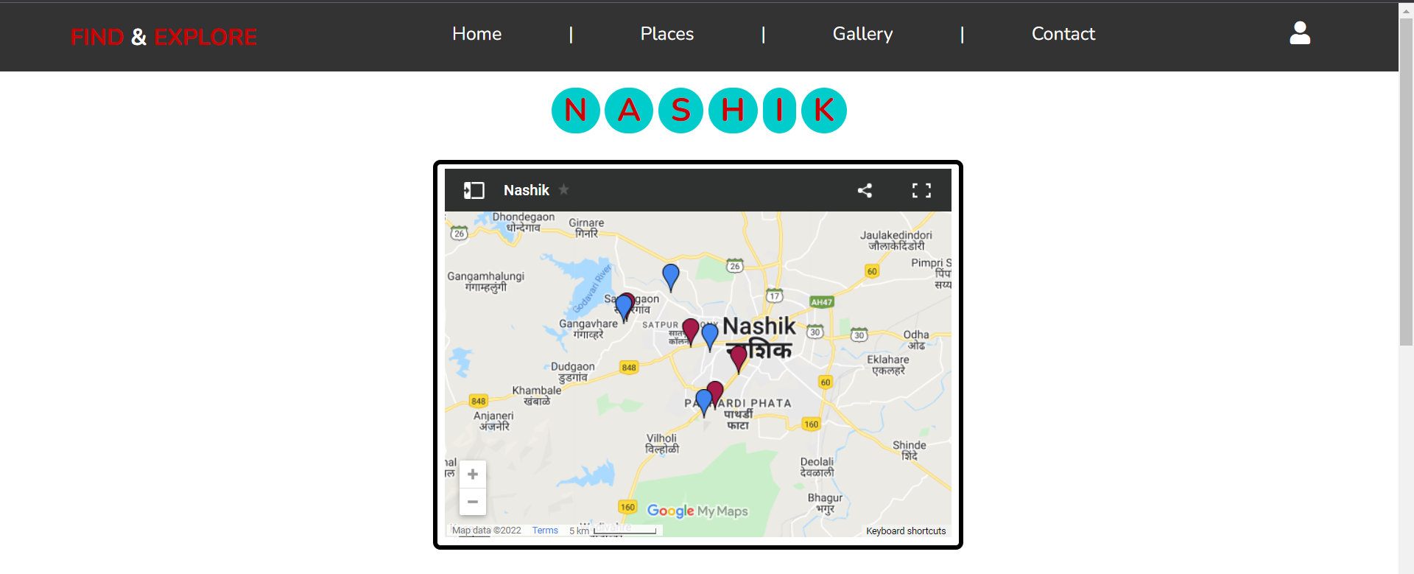
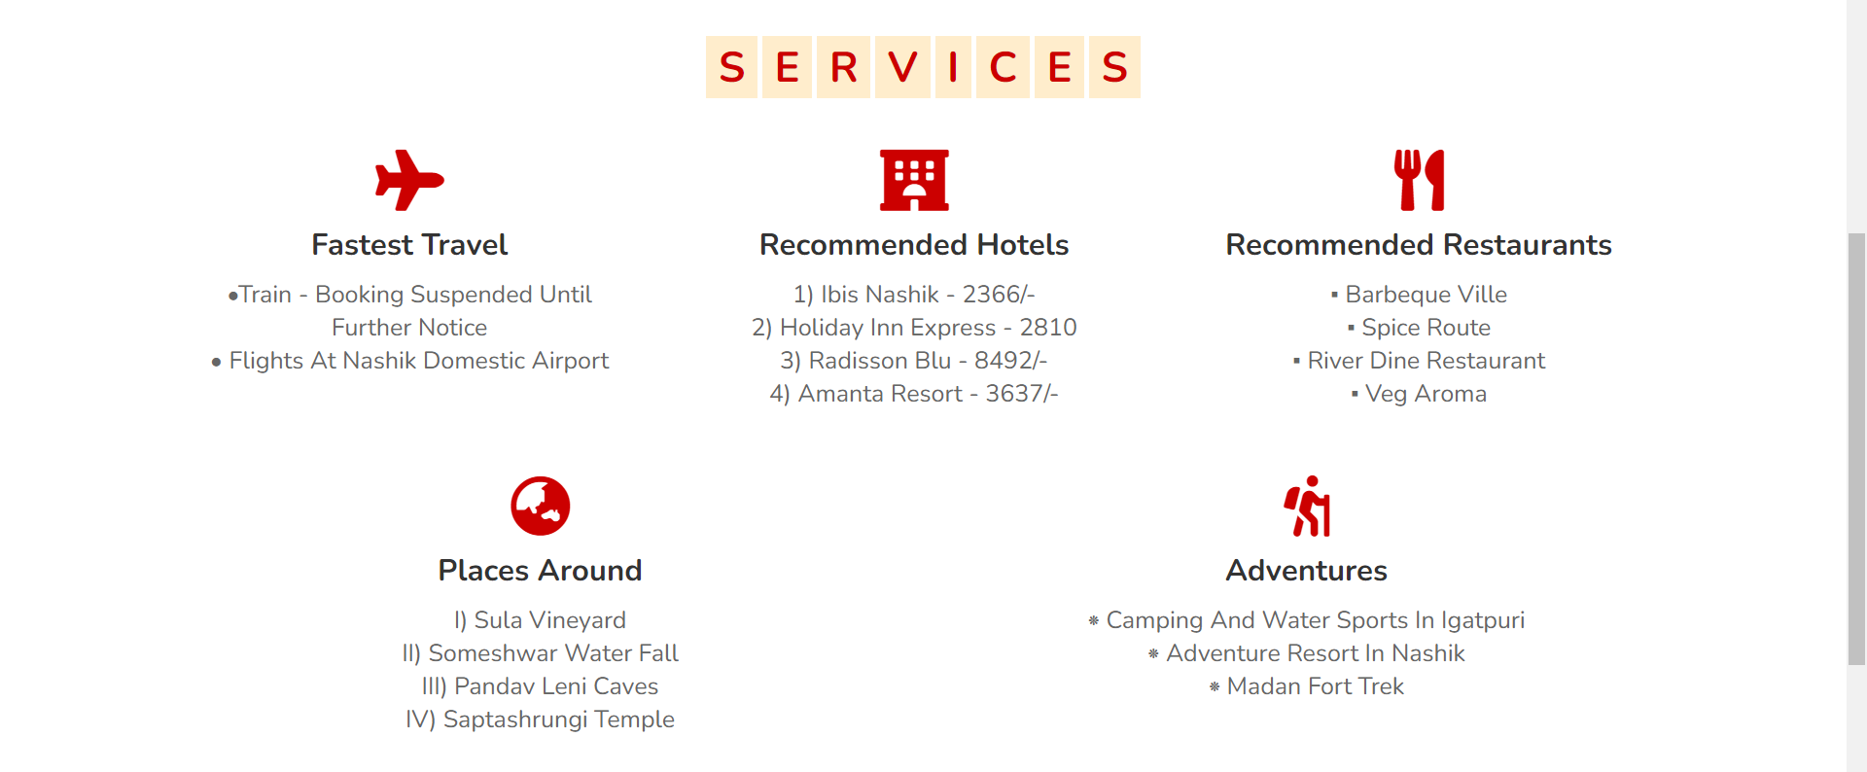

Slide 15
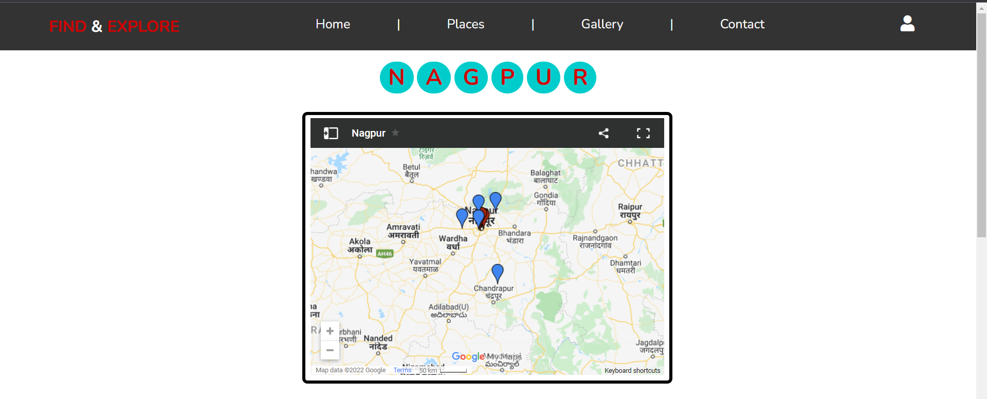
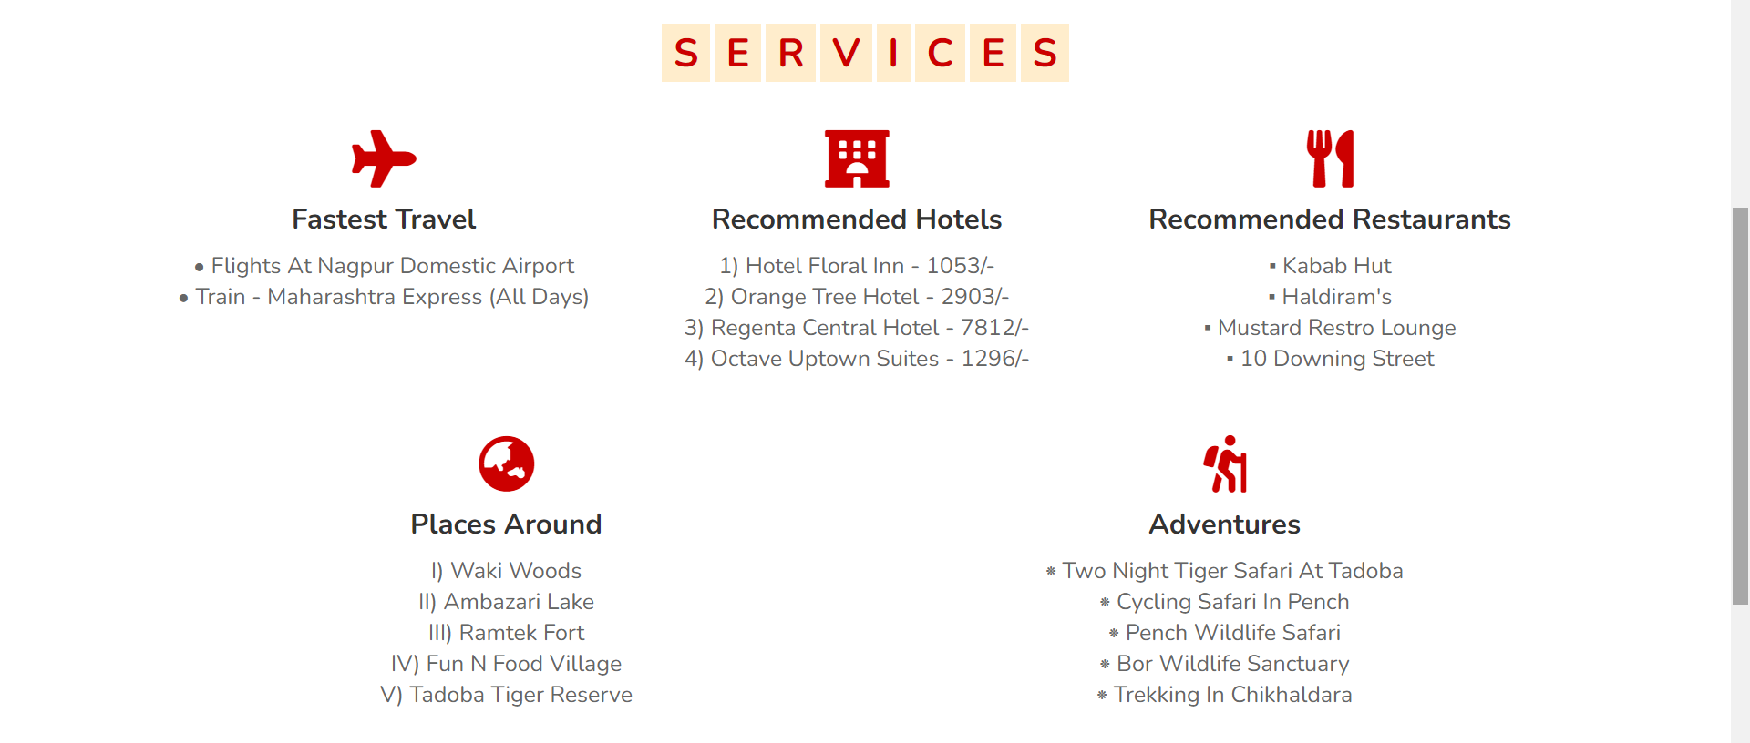

Slide 16
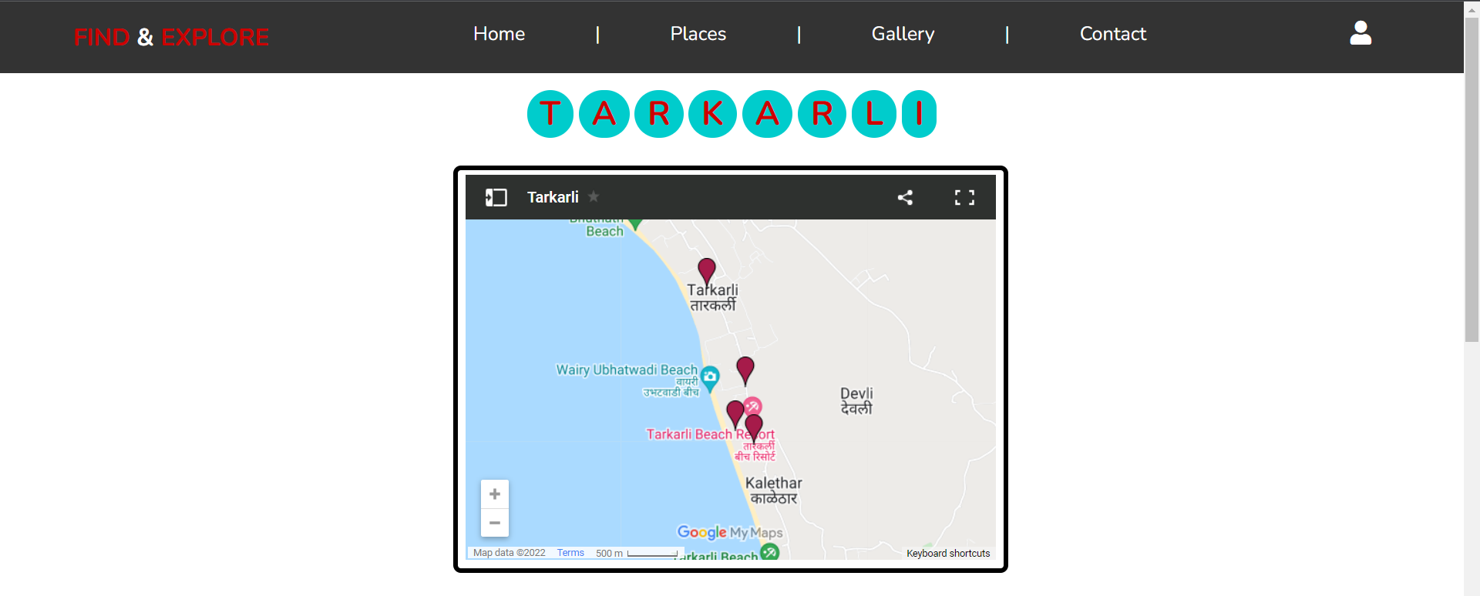
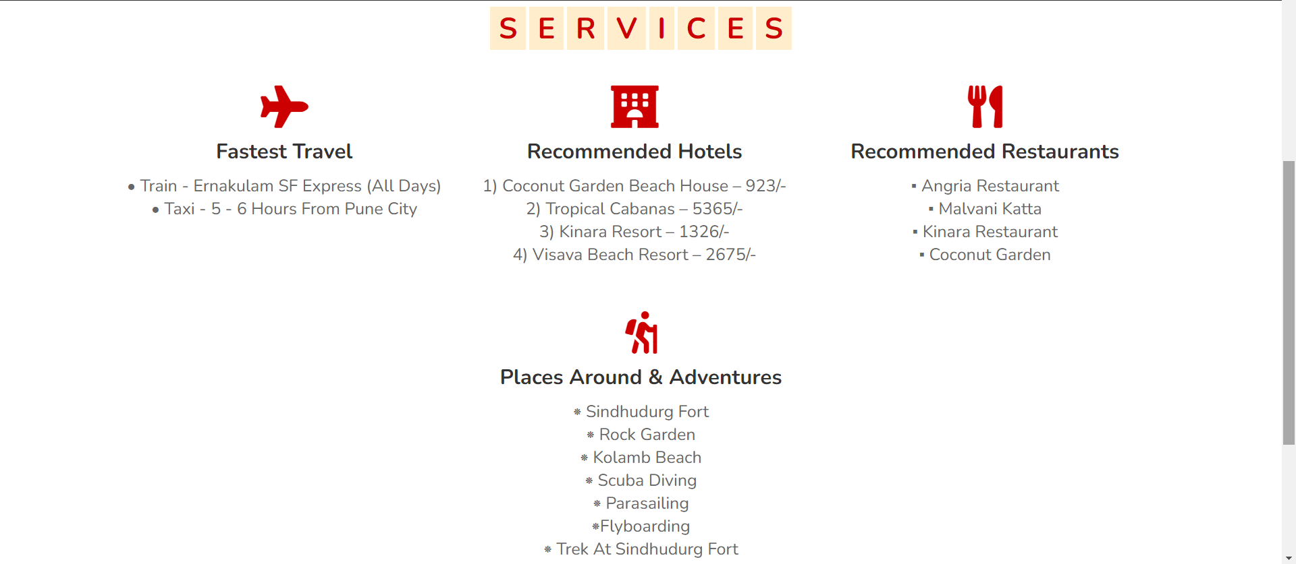

Slide 17
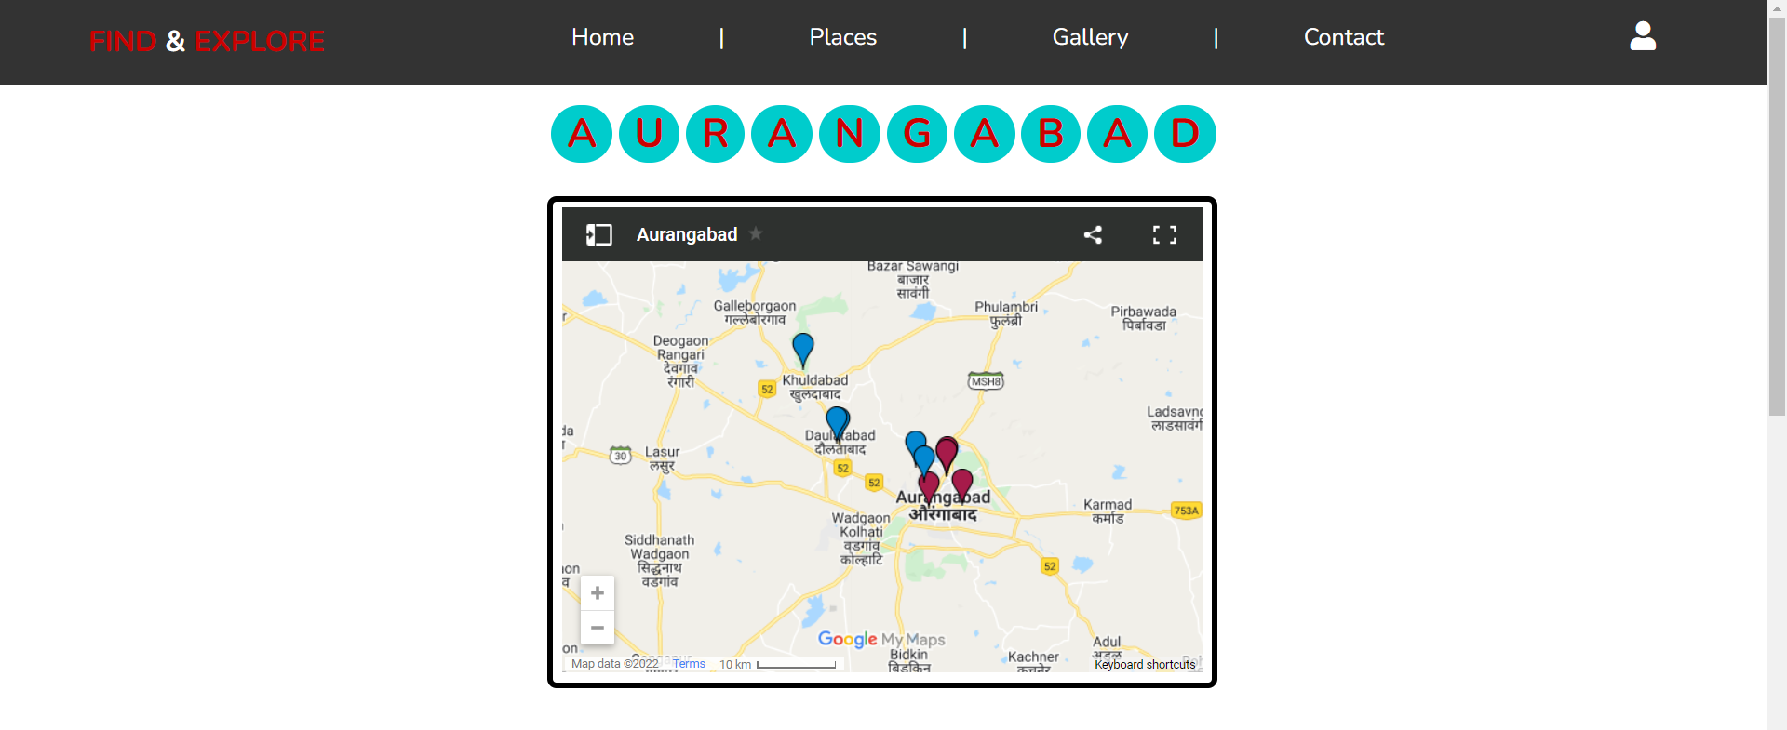
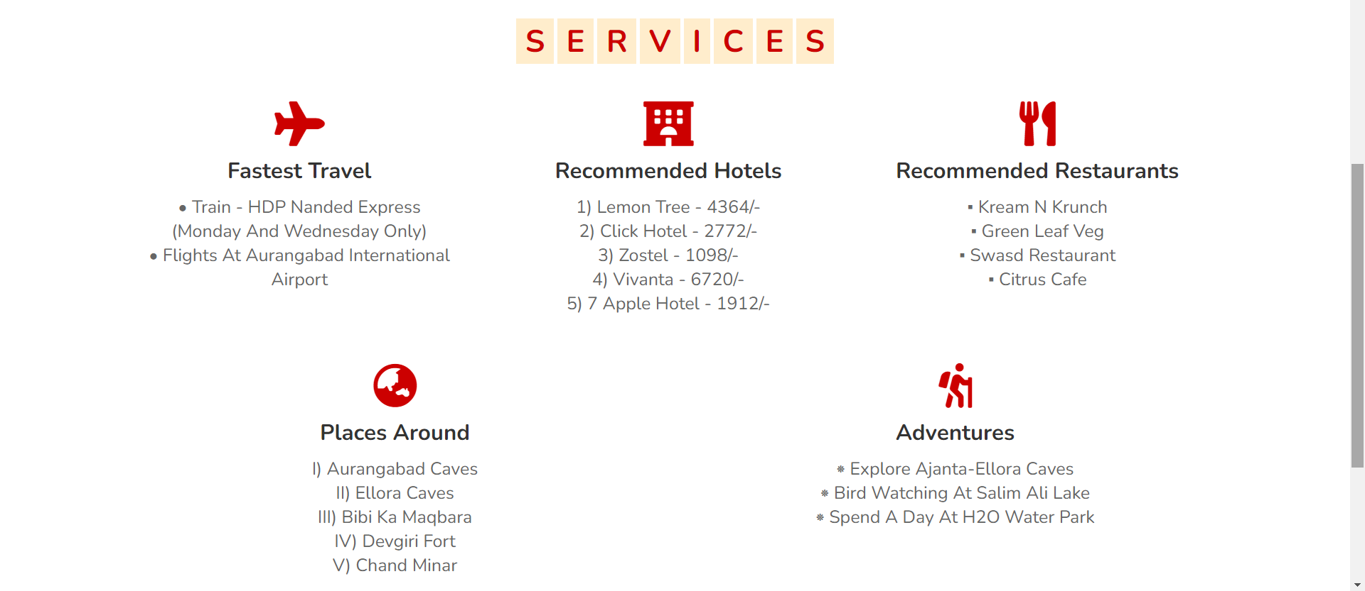

Slide 18
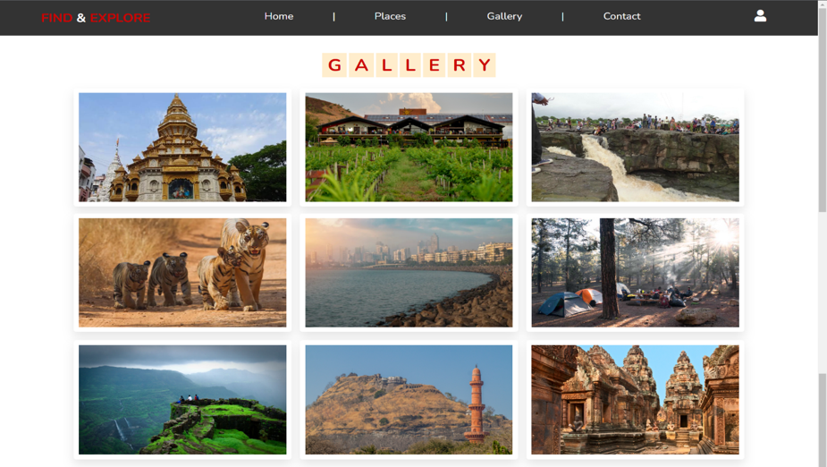
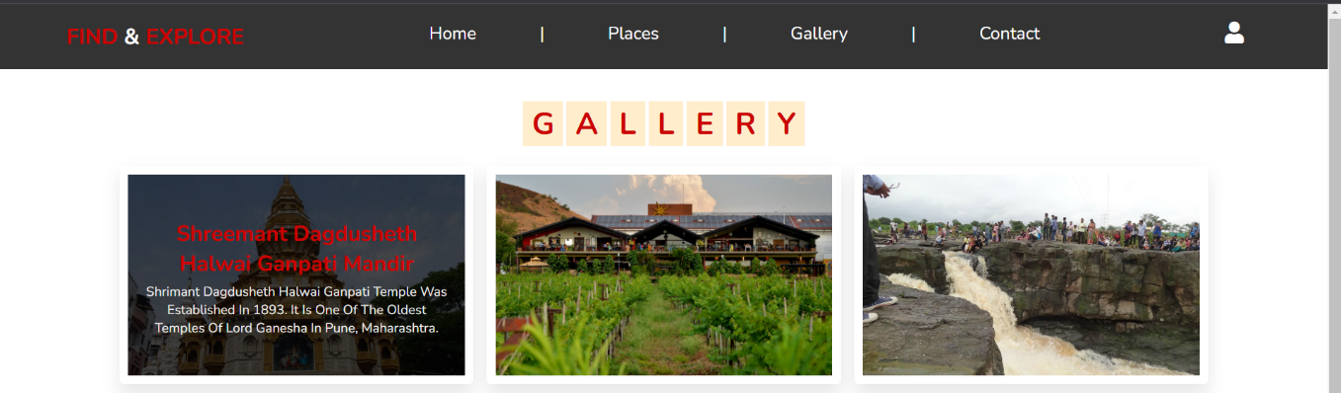
Information on Hover: -

Slide 19
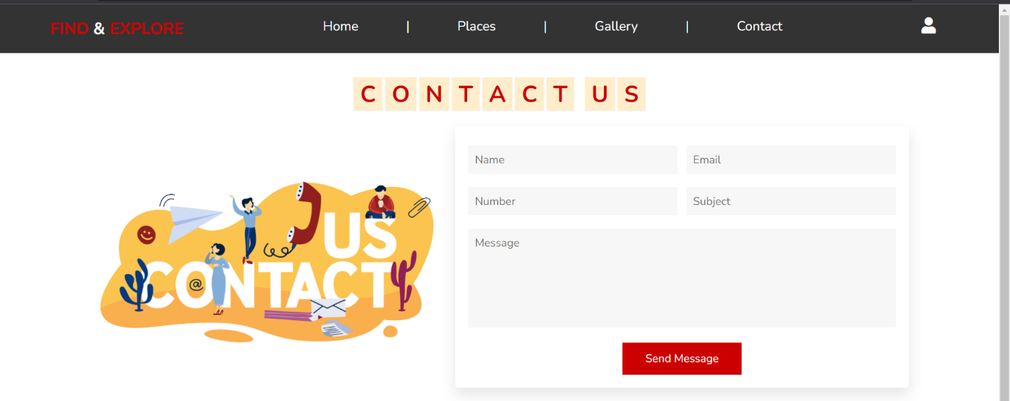
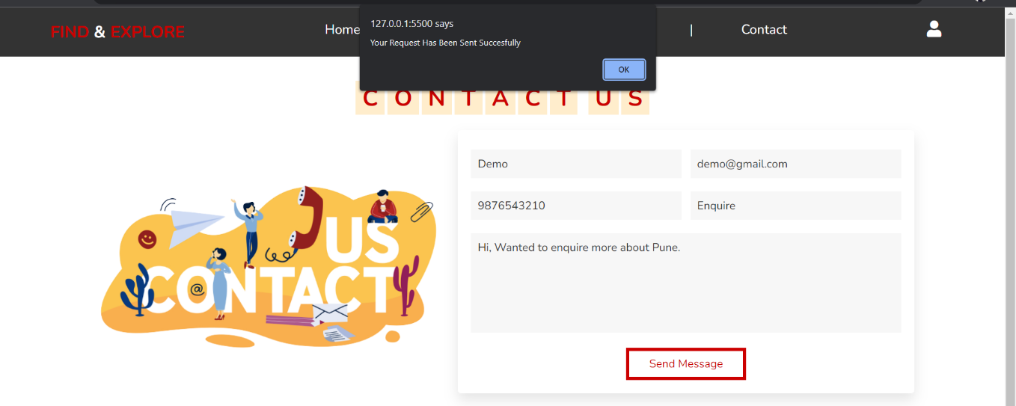
Contact Request Submitted: -

Slide 20


Slide 21
Hardware and Software Requirement
Minimum Hardware Requirements: -
1. Processor – Intel Core i3
2. Memory- 4GB RAM
Minimum Software Requirements: -
1. OS- Windows 10
2. Front End-
Visual Studio Code 1.67.1 or Higher
Google Chrome 101.0.4951.64 or Higher
Any other Web Browsing Software
Requires Stable Internet Connection

Slide 22
Future Scope
Tourism Information System is a website developed for tourists and tourism destinations that are situated in the State of Maharashtra.
If this project is brought into use, then it would be much easier for tourists to find relevant information about various travel destinations.
To provide travel packages at discounted price and accept bookings regarding same.
To accept feedback from members.
The capability of this website could be further increased to a larger area if its application is successful.

Slide 23
Conclusion
This website was successfully created to store all the Travel Information like affordable hotels, efficient modes of transport, interesting places to visit and to try local delicacies. After the completion of this website, we conclude that the goal behind the creation of this website was successfully achieved and it is characterized by ease of use in finding the appropriate information. Thus, it was executed perfectly. We look forward to continuing the further development of this project.

Slide 24
THANK YOU!
Karan Nawal and Sohana Joglekar
Roll Number
14412 & 14415

